Slide 1
Capstone Project 2
By Sandy Duong
Notes:
INTRO*****
I gather everyone here today to provide you all with analysis around vehicle fuel economy. I want to go into depth about what might drive fuel economy and annual fuel costs higher, and what we can focus on to maximize fuel economy and to lower costs.

Slide 2
What is important?
In this day and age, people want to save on money
When renting a car people primarly focus on
Gas mileage (MPG)
Low fuel cost
Different vehicle types and fuel types can
Increase MPG
Lower annual fuel cost
Today we’ll look at certain variables and see how we can take advantage of it to advance your business objectives
Notes:
Today we live in a world where I think a lot of people are very conscious of their environmental footstep and their finances as well.
This reflects on how they live their every day lives
When renting a car, people nowadays want more out of their car with the thought of it being less harmful for the environment, and to also get the biggest bang for their buck.
I want to look at certain variables and see how we increase the amount of rentals people make through our website, display cars more accurately suited to their beliefs and lifestyle.

Slide 3
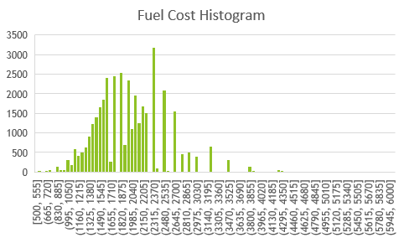
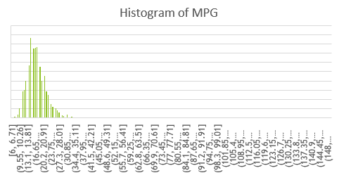

Slide 4
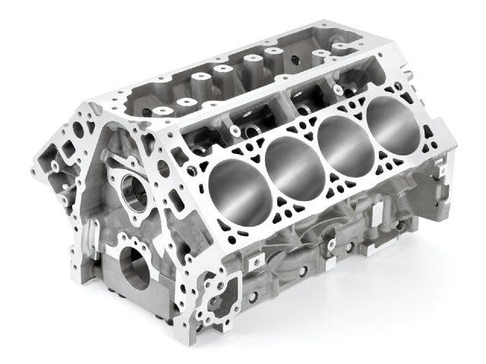
Economy cars vs High performance cars
Alternative: lower number of cylinders will result in a higher MPG
Null: Number of cylinders has no affect on MPG
Looking at data, lower number of cylinders will result in a lower MPG
P – value = 2.495E-10
Notes:
****state hypothesis
***(mention all tests performed were done with a CI of 95%)
People would like to use more practical cars and I think listing cars that are more gas efficient will attract more people. The more cylinders an engine has the more gas they consume which in turn will have a lower MPG
After conducting a t-test, the p-value I obtained is less than our alpha which is 5% which rejects the null hypothesis stated in favor of the alternative.

Slide 5
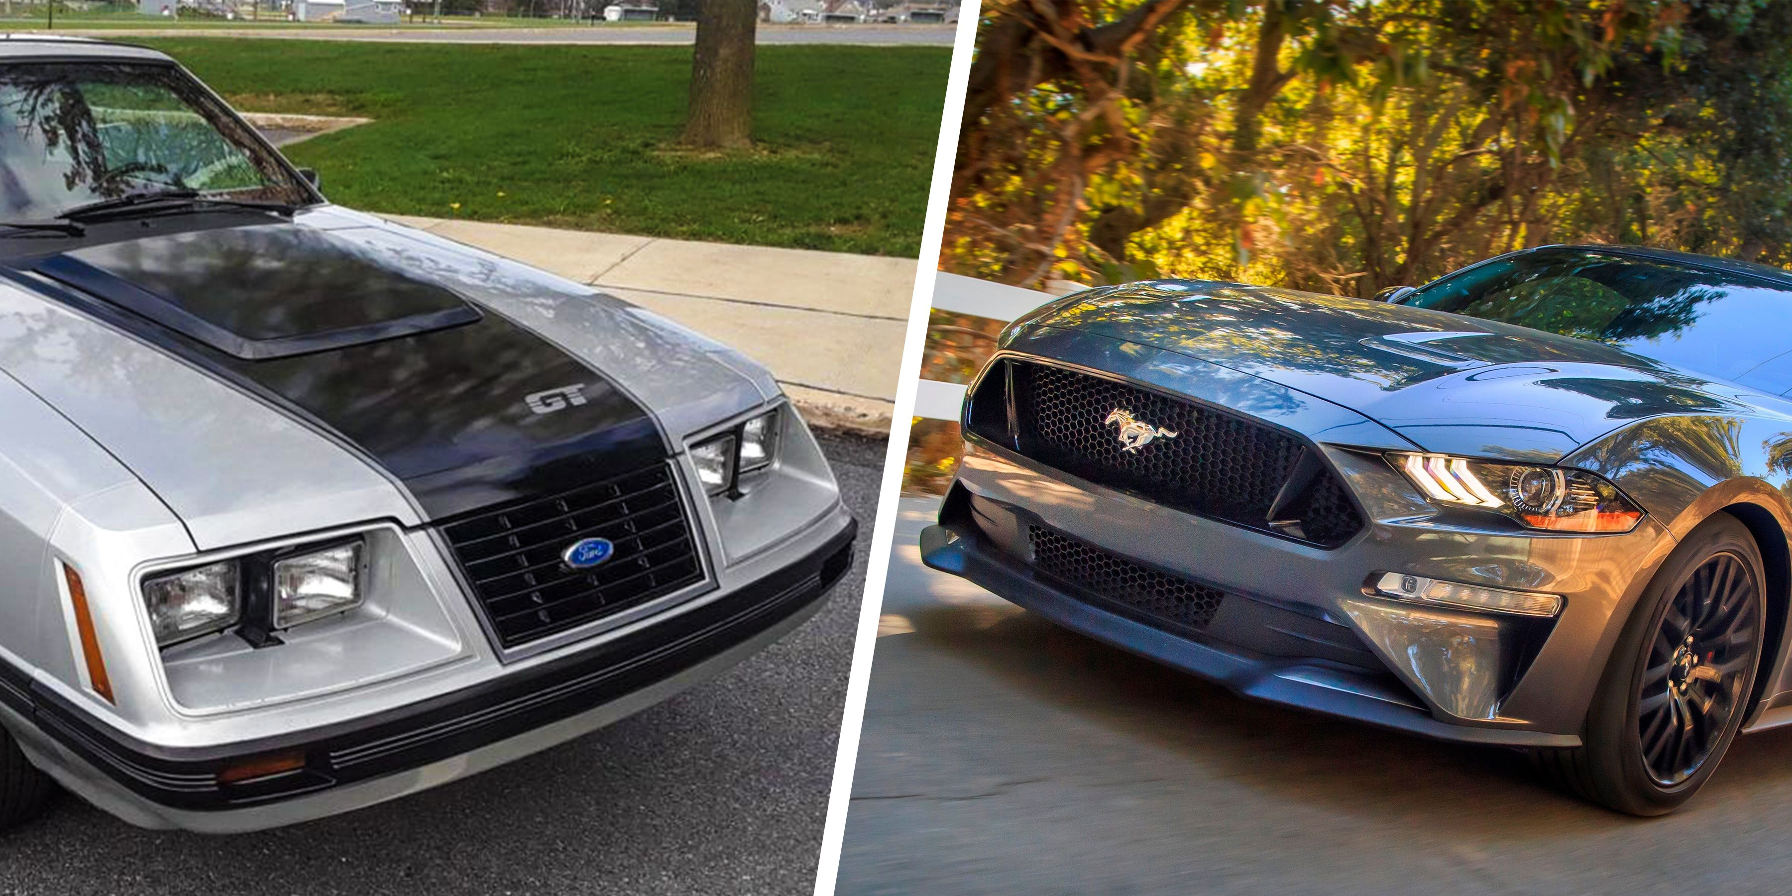
Newer cars vs Older cars
Alternative: Driving a newer car will greatly increase the MPG
Null: Driving a newer car has no effect on MPG
Looked at data for each year’s cars and compared average MPG
P-value = 0.394
Notes:
*****state hypothesis
I wanted to explore the option of buying newer cars because I figure the newer the technological advances in manufacturing should be making newer models of cars more gas efficient. I compiled a list with all cars made from each year and calculated the average MPG and it looked to me that the more recent the car was manufactured that the MPG was getting higher and higher each year.
The p-value here is actually much greater than our alpha of 5% or 0.05, and we can safely reject the alternative hypothesis in favor of the null and conclude that driving a newer car has no effect on MPG

Slide 6
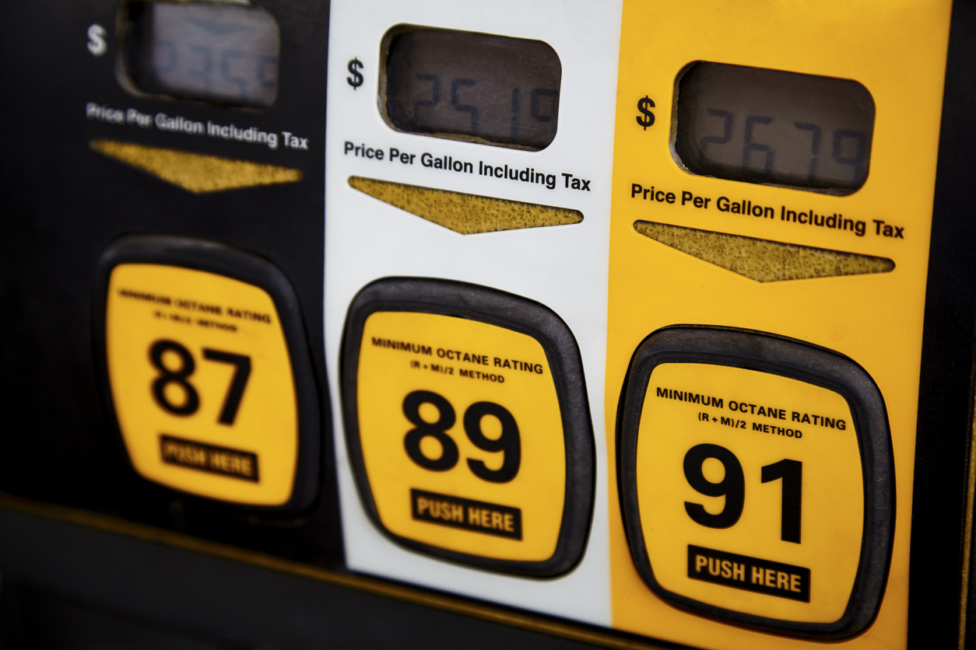
Fuel types vs MPG
Alternative: cars running on regular gasoline will have a higher MPG
Null: the type of gasoline has no effect on MPG
6 different types of fuel, with premium and regular being the majority
P-value = 1.893E-8
Notes:
******state hypothesis
Cars that use regular gasoline are more likely to not be a high performance car and are likely to get a higher MPG. You generally find people using the most premium gas if they are driving luxury vehicle which are high performance a lot of the times. In this set of data I have 6 different types of fuel but majority of the cars are either using regular or premium most of the time.
The p valuej here is less than our alpha of 5% so we can safely reject the null hypothesis and have some support in favor of our alternative that cars running on regular gasoline will have a higher MPG.

Slide 7

Fuel type vs Annual fuel costs
Alternative: Electric cars have a lower fuel cost than cars that run on gasoline
Null: Electricity as the main energy source has no effect on fuel costs.
Electric cars don’t use any gasoline and is just based on the price of charging it
P-value = 1.764E-16
Notes:
*******state hypothesis
I’ve worked at tesla and at tech companies that use electric vehicles and I believe they are extremely cost efficient. The charging costs of an EV are purely based on just your electrical bill which usually is a lot lower than a full tank of gasoline for your average car. I looked at the data and looked at the average annual fuel cost per year for each type of fuel, and electricity was lower by a big margin.
The-pvalue here is lower than our alpha at 5% so we can reject the null hypothesis and have evidence to support the alternative that electric cars have a lower “fuel cost” than cars that run on gasoline. (state that fuel costs of an EV are related to the electricity bill)

Slide 8
In conclusion
Focus our maintenance on economy cars
Cars that run on regular gasoline
More electric vehicles
Users more concerned with saving money and being more environmentally friendly
They also want to get the most out of their money
Notes:
Should be listing more cars that are practical for the everyday American, people aren’t generally going to be renting nicer more expensive vehicles.
Focus more on cars that run on regular gasoline and more electric vehicles.
Like I said at the beginning, more users are concerned with saving money and being more environmentally friendly, and these types of cars fit the bill on that.
An added bonus is if they know they are saving money and getting the most out of it.

Slide 9


